Slide 1


JavaScript for test engineers
Module #5 – JSON, Promise, RegExp

Slide 2

Agenda
1
JSON
2
SYNC/ASYNC
3
PROMISE
4
Regexp basics
5
callback

Slide 3
JSON

Slide 4
JSON
JSON (JavaScript Object Notation) is a lightweight data-interchange format.
JSON is built on two structures:
A collection of name/value pairs. (Object)
An ordered list of values. (Array)
(!) Keys as strings
(!) No comments
{
”string”: ”World”,
”number”: 1.23,
”boolean”: false,
”array”: [1, 2, true, ”Smth”],
”otherObject”: {
”hi”: ”!”
}
}

Slide 5
JSON
JSON: global object with static methods:
stringify(): Return a JSON string corresponding to the specified value
parse(): Parse a string as JSON and return the value.
const obj = {
hello: ”Word”,
boolean: false,
number: 1.23,
obj: { key: ”value” },
arr: [1, 2, true]
};
const objStr = JSON.stringify(obj);
// ”{ \”hello\”: \”World\”, \”boolean\”: false, ... }”
const objAgain = JSON.parse(objStr);
// { hello: ”World”, boolean: false, ... }

Slide 6
I/O
JSON files: files containing a JSON string
Load with simple NodeJS: require
Read/Write with fs NodeJS package
...
// assume we have myData.json with: { \”hello\”: \”world\” }
const myData = require(”./myData.json”);
// { hello: ”world” }
const fs = require(”fs”);
// read
let myFsData = fs.readFileSync(”./myData.json”, ”utf-8”);
myFsData = JSON.parse(myFsData);
// write
myFsData.hello = ”again”;
fs.writeFileSync(”./myData.json”, JSON.stringify(myFsData));
// { \”hello\”: \”again\” }

Slide 7
I/O
Use OS NPM package: jsonfile
Combines fs & JSON
Also applies formatting
https://www.npmjs.com/package/jsonfile
// assume we have myData.json with: { \”hello\”: \”world\” }
// npm install jsonfile –save
const jsonfile = require(”jsonfile”);
const myData = jsonfile.readFileSync(”./myData.json”);
myData.hello = ”again”;
jsonfile.writeFileSync(”./myData.json”, myData, { spaces: 2 });
// {
// \”hello\”: \”again\”
// }

Slide 8
SYNC/ASYNC

Slide 9
SYNC/ASYNC
Two or more things are synchronous when they happen at the same time (in sync), and asynchronous when they don’t (not in sync).
Typically:
setTimeout/setInterval
AJAX calls
function a() {
console.log(’a’);
}
// sync:
a();
console.log(’b’);
// a, b
// async:
setTimeout(a, 100);
console.log(’c’);
// c, a

Slide 10
HANDLING ASYNC ACTIONS
Callbacks
Execute a function when async action done which recieved by an argument → callback should be passed on all levels
Promise
function schedule(fn, done) {
setTimeout(function () {
fn();
done();
}, 1000);
}
function ticTac(done) {
const tick = () => console.log(’tick’);
const tack = () => console.log(’tack’);
schedule(tick, function () {
schedule(tack, function () {
schedule(tick, function () {
schedule(tack, done);
});
});
});
}

Slide 11
PROMISE

Slide 12
PROMISE
The Promise interface represents a proxy for a value not necessarily known at the moment
Allows us to associate handlers to an asynchronous action's eventual success or failure
Lets asynchronous methods return values like synchronous ones
Returns a promise of having a value at some point in the future
var p = new Promise(function(resolve, reject) {
// Do an async task async task and then...
if(/* good condition */) {
resolve('Success!');
} else {
reject('Failure!');
}
});
p.then(function() {
/* do something with the result */
}).catch(function() {
/* error :( */
});
Promise.resolve(2);
Promise.reject(”Error happened!”);

Slide 13
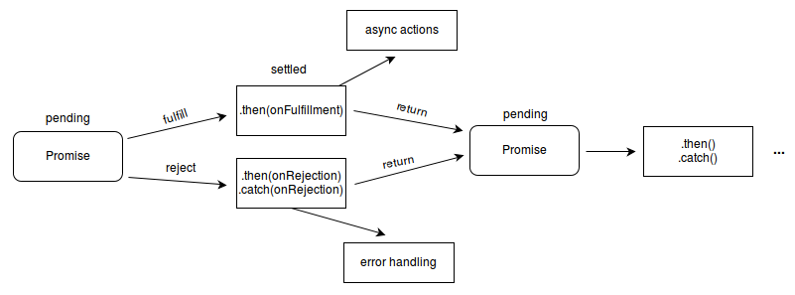
LIFE CYCLE OF A PROMISE

Slide 14
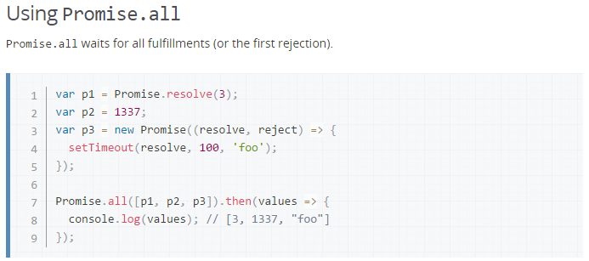
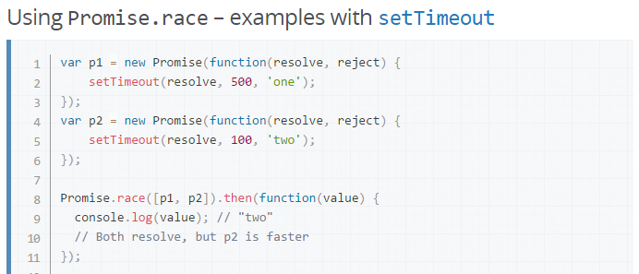
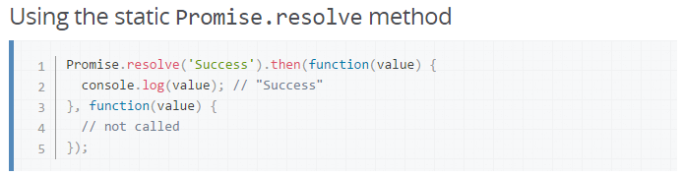
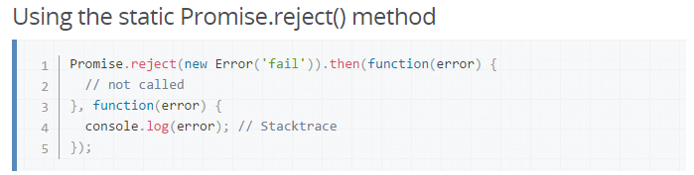
PROMISE.ALL, RACE, REJECT, RESOLVE

Slide 15
PROMISE / CALLBACK
function writeHi(done) { setTimeout(function () { console.log(”Hi!”); done(); }, 1000); }
function writeHo(done) { setTimeout(function () { console.log(”Ho!”); done(); }, 2000); }
writeHi();
writeHo();
console.log(”Done!”);
// 0 -> Done!
// 1000 -> Hi!
// 2000 -> Ho!
writeHi(function () {
writeHo(function () {
console.log(”Done!”);
});
});
// 1000 -> Hi!
// 3000 -> Ho!
// 3000 -> Done!

Slide 16
PROMISE / CALLBACK
function writeHi() { return new Promise(function (resolve) { setTimeout(function () { console.log(”Hi!”); resolve(); }, 1000); }); }
function writeHo() { return new Promise(function (resolve) { setTimeout(function () { console.log(”Ho!”); resolve(); }, 2000); }); }
writeHi().then(function (){
writeHo().then(function () {
console.log(”Done!”);
});
});
// 1000 -> Hi!
// 3000 -> Ho!
// 3000 -> Done!
Promise.all([
writeHi(),
writeHo()
]).then(function () {
console.log(”Done!”);
});
// 1000 -> Hi!
// 2000 -> Ho!
// 2000 -> Done!

Slide 17
Regexp basics

Slide 18
REGULAR EXPRESSIONS
Regular expressions are patterns used to match character combinations in strings.
https://www.debuggex.com/cheatsheet/regex/javascript
Regular Expression Basics
. | Any character except newline
a | The character a
ab | The string ab
a|b | a or b
a* | 0 or more a's
\ | Escapes a special character
Regular Expression Quantifiers
* | 0 or more
+ | 1 or more
? | 0 or 1
{2} | Exactly 2
{2, 5} | Between 2 and 5
{2,} | 2 or more
Default is greedy. Append ? for reluctant.

Slide 19
REGULAR EXPRESSIONS
Regular Expression Groups
(...) | Capturing group
(?:...) | Non-capturing group
\Y | Match the Y'th captured group
Regular Expression Character Classes
[ab-d] | One character of: a, b, c, d
[^ab-d] | One character except: a, b, c, d
[\b] | Backspace character
\d | One digit
\D | One non-digit
\s | One whitespace
\S | One non-whitespace
\w | One word character
\W | One non-word character
Regular Expression Assertions
^ | Start of string
$ | End of string
\b | Word boundary
\B | Non-word boundary
(?=...) | Positive lookahead
(?!...) | Negative lookahead

Slide 20
REGULAR EXPRESSIONS
Regular Expression Flags
g | Global Match
i | Ignore case
m | ^ and $ match start and end of line
Regular Expression Special Characters
\n | Newline
\r | Carriage return
\t | Tab
\0 | Null character
\YYY | Octal character YYY
\xYY | Hexadecimal character YY
\uYYYY | Hexadecimal character YYYY
\cY | Control character Y
Regular Expression Replacement
$$ | Inserts $
$& | Insert entire match
$` | Insert preceding string
$' | Insert following string
$Y | Insert Y'th captured group

Slide 21
Regexp IN JAvaScript

Slide 22
IN JAVASCRIPT
In JavaScript, regular expressions are also objects.
These patterns are used with the exec and test methods of RegExp, and with the match, replace, search, and split methods of String.

Slide 23
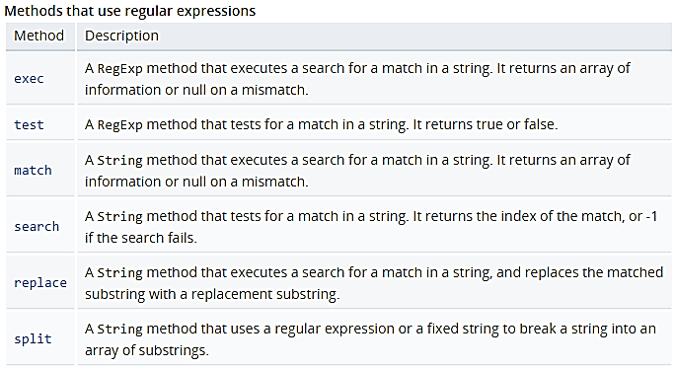
METHODS

Slide 24
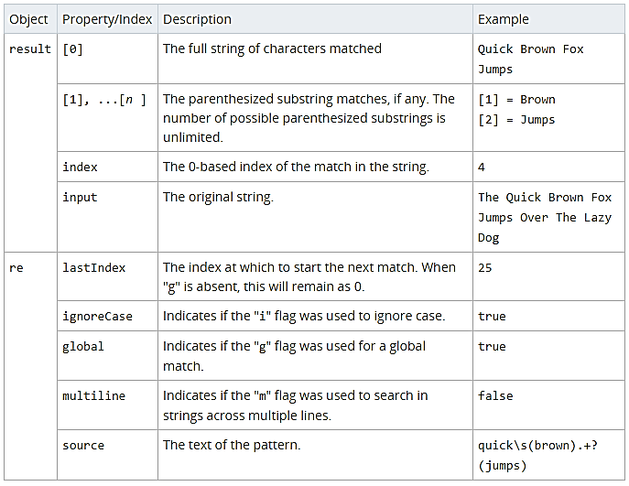
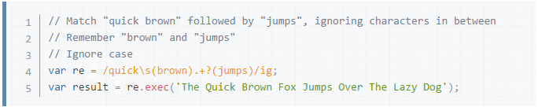
EXEC
The exec() method executes a search for a match in a specified string.
Returns a result array, or null.

Slide 25

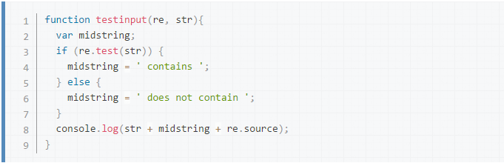
TEST
The test() method executes a search for a match between a regular expression and a specified string.
Returns true or false.

Slide 26
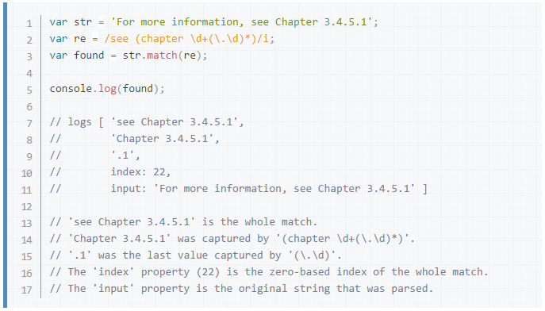
MATCH
The match() method retrieves the matches when matching a string against a regular expression.
Returns sn Array containing the entire match result and any parentheses-captured matched results; null if there were no matches.

Slide 27
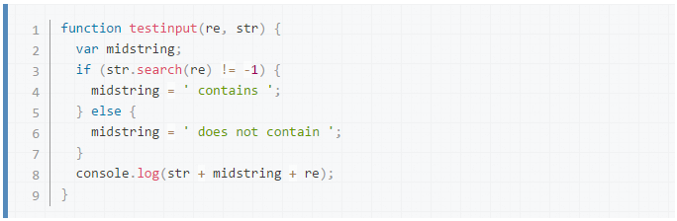
SEARCH
The search() method executes a search for a match between a regular expression and this String object.
Returns the index of first match.

Slide 28
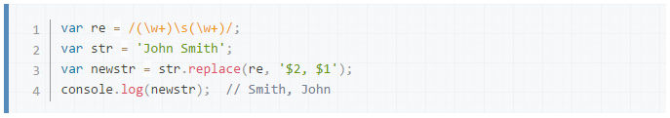
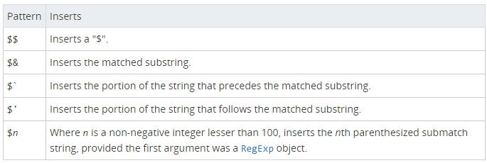
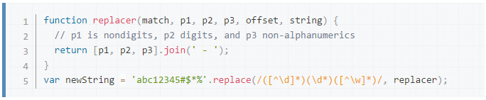
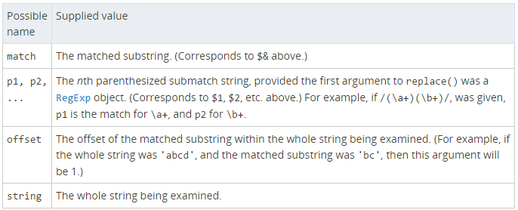
REPLACE
The replace() method returns a new string with some or all matches of a pattern replaced by a replacement.
The pattern can be a string or a RegExp, and the replacement can be a string or a function to be called for each match.

Slide 29
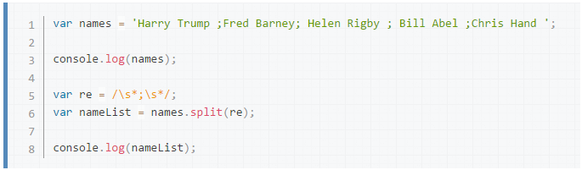
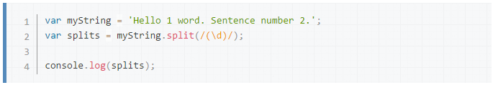
SPLIT
The split() method splits a String object into an array of strings by separating the string into substrings.

Slide 30
Questions?

